Slide 1


ONLINE
DOCTOR cONSULTANCY
(WEEK-1)
RA1911027010104( K.SNEHAL KUMAR(leader))
RA1911027010108(A.UDAY KIRAN REDDY)
RA1911027010109(N.VEERA VENKATA GANESH)

Slide 2
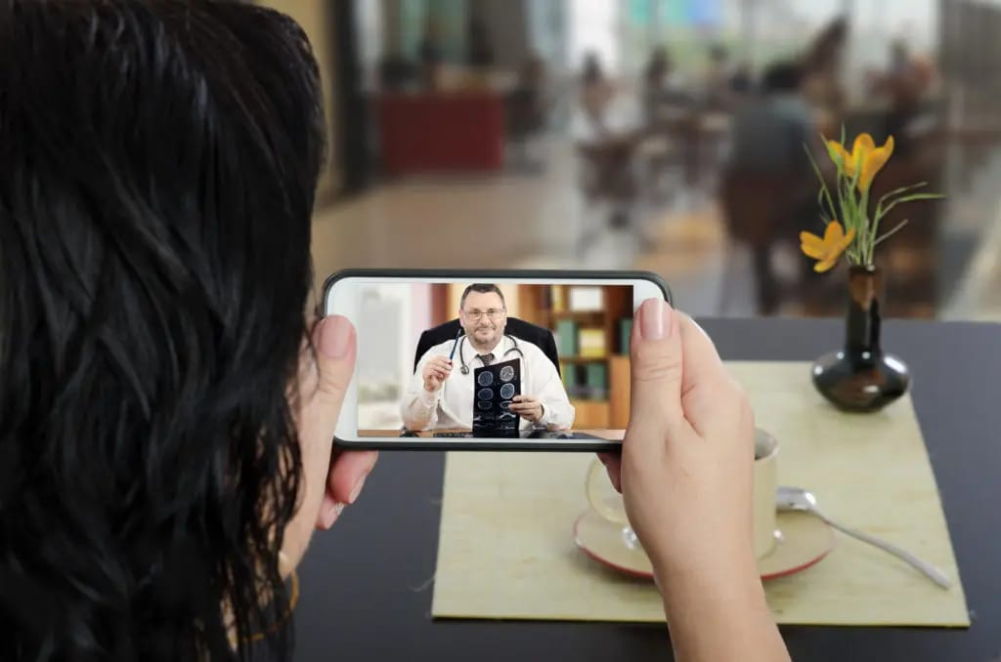
Online doctor consultation or 'telemedicine' is the provision of clinical services like appointment, diagnosis, treatment, prescription, and follow-ups using communication technology.

Slide 3
DETAILS TO BE FILLED
PATIENT NAME:
SEX: M/F
AGE:
MOBILE NUMBER:
EMAIL ID:
ADRESS:
COUNTRY:
STATE:

Slide 4
APPOINTMENT DETAILS
APPOINTMENT DATE :
SPECIALITY:
1)Pediatrician 4)Physician 7)Gynaecologist 10)Dermatologist 2)Dietitian 5)Orthopedician 8)Cardiologist 11)General surgeon 3)Pulmonologist 6)Neurosurgeon 9)Endocrinologist 12) Dentist
PREFERRED HOSPITAL:
PREFERRED DOCTOR :
ABOUT THE MEDICAL ISSUE:
In Case of having any previous medical record:
UPDATE THE FILE HERE:

Slide 5
OBJECTIVES:
To develop a system that allows the users to have a control over their appointing system through online
To facilitate the patients with real time health care scheduling
To maximize the duration of consultancy
To make the use of online platforms for less customer inconvienience

Slide 6
POTENTIAL BENFITS:
Online patient scheduling has its tangetial benefits toboth users and the hospital management
ACCESSIBILITY:
Online scheduling software is accessible for all types of users all that needed is internet connection .
SECURITY: maintains patient information confidential as of the will get an username and password through this they can access .

Slide 7
BENEFITS OF THE PROJECT:
Prompt medical attention
Get a second opinion
Access to specialists
Privacy & availability
Comfort and convenience
Cost-effective and time-saving
No need to save all the medical reports
Fewer chances of catching a new illness
Minimizing travel charges

Slide 8
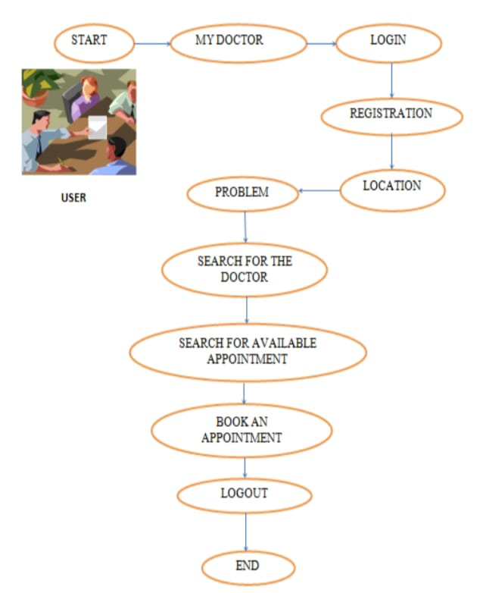
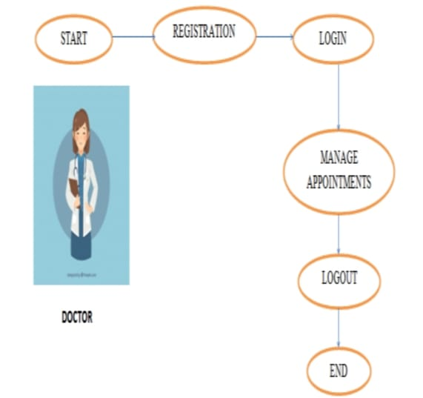
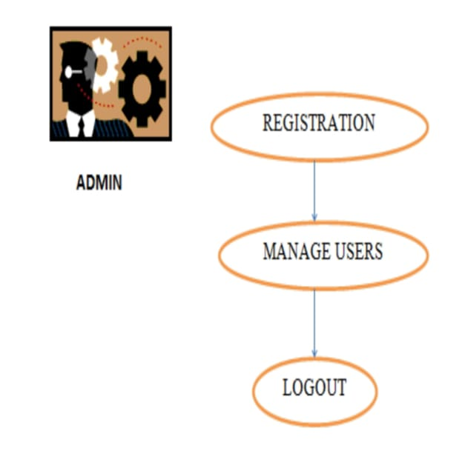
Steps to follow:

Slide 9


ONLINE DOCTOR CONSULTANCY(week-2)
RA1911027010104( K.SNEHAL KUMAR(leader))
RA1911027010108(A.UDAY KIRAN REDDY)
RA1911027010109(N.VEERA VENKATA GANESH)

Slide 10
DESCRIPTION:
Agile management is the application of the values established primarily for the technology domain as Agile software development. Today the methodology is becoming more prevalent in various management techniques in other industries. Trailing the appearance of the Agile Software Development domain in 2001, Agile systems began to scatter into other areas of activities . Because Agile methodology values are based on the combination of experience throughout the delivery process, it can be a useful model for small medical practices.

Slide 11
Agile Methodology:
Agile methods were seen initially as best suitable for non-critical service and product domains, thereby barred from use in regulated fields such as medical devices, pharmaceutical, financial, nuclear systems, automotive, and avionics sectors, etc. However, recently, there have been some drives for the adoption of agile methods for non-technology domains.

Slide 12
Agile Management is the Application of Healthcare Values: Agile management is the application of the values established primarily for the technology domain as Agile software development.
Evolution of Agile Methodology :
Agile methodology encompasses many strategies to patient management under which requirements and solutions unfold through the collaborative exertion of self-organizing and cross-functional teams and their patients.

Slide 13
Planning for Agile Methodology: It is not too uncommon for teams to fall into the trap of spending too much time preparing or planning.
Project Life-Cycle in Agile Methodology : Agile methods support a broad range of development or implementation life cycle. Some focus on the practices, while some focus on managing the flow of work.
The Quality focus in Agile Methodology : Various tools are often used to improve quality and enhance products or services in Agile.

Slide 14
Identification of Stakeholders:
Patients
Doctors
Researchers
Technical Team
Marketing Team

Slide 15
ONLINE DOCTOR CONSULTANCY
(Week-3)
RA1911027010104( K.SNEHAL KUMAR(leader))
RA1911027010108(A.UDAY KIRAN REDDY)
RA1911027010109(N.VEERA VENKATA GANESH)

Slide 16
PROJECT SCOPE:
Project scope is the part of project planning that involves determining and documenting a list of specific project goals, deliverables, features, functions, tasks, deadlines, and ultimately costs. In other words, it is what needs to be achieved and the work that must be done to deliver a project.

Slide 17
EPICS:
Admin Login
User login/registration
Clinic areas
Appointment availability check
Appointment booking online for date and time
Automatic cost calculation
Booking cancellation
Email on appointment booking
Feedback

Slide 18
Functional Requirements: “Any Requirement Which Specifies What The System Should Do.”
Some of the more typical functional requirements include:
1)Business Rules
2)Transaction corrections, adjustments and cancellations
3)Administrative functions
4)Authentication
5)Authorization levels
6)Audit Tracking
7)External Interfaces
8)Certification Requirements
9)Reporting Requirements
10)Historical Data
11)Legal or Regulatory Requirements

Slide 19
non-functional requirements: “Any Requirement That Specifies How The System Performs A Certain Function.”
Some typical non-functional requirements are:
1)Performance – for example Response Time, Throughput, Utilization, Static Volumetric
2)Scalability 9)Security
3)Capacity 10) Regulatory
4)Availability 11) Manageability
5)Reliability 12) Environmental
6)Recoverability 13) Data Integrity
7)Maintainability 14) Usability
8)Serviceability 15) Interoperability

Slide 20
INFRASTUCTURE REQUIREMENTS: “infrastructure requirements define the capabilities, features or qualities that are necessary (or desired) for an infrastructure on which to execute the application”.
Hardware Requirements:
SL | Software | Minimum System Requirement
1 | Operating System | Windows Server 2008,Windows7
2 | Database Management System | Microsoft SQL Server 2014
3 | Runtime Environment | Visual Studio 2008 Team System
Software Requirements:
SL | Software | Minimum System Requirement
1 | Operating System | Windows Server 2008,Windows7
2 | Database Management System | Microsoft SQL Server 2014
3 | Runtime Environment | Visual Studio 2008 Team System

Slide 21
ONLINE DOCTOR cONSULTANCY (week-4)
RA1911027010104( K.SNEHAL KUMAR(leader))
RA1911027010108(A.UDAY KIRAN REDDY)
RA1911027010109(N.VEERA VENKATA GANESH)

Slide 22
this website provides their users the following features:
A professional looking website
A detailed page to find a doctor depending on client’s needs and availability
Online appointment making
Detailed list of provided services
Contact form
Info about all their facilities

Slide 23
Process for Cost Estimation:
1)Define Estimate’s Purpose
2)Develop Estimating Plan
3)Define Characteristics
4)Determine Estimating Approach
5)Identify Rule and Assumptions
6)Obtain Data
7)Develop Point Estimate
8)Conduct Sensitivity Analysis
9)Conduct Risk and Uncertainty Analysis
10)Document the Estimate
11)Present Estimate to Management
12)Update Estimate

Slide 24
Types of users:
Guests: Those are the users that are not registered and access our website. We can say that they are our potential clients so we have to let them see all the information they might be interested in about services provided by a clinic.
Patients: This user group is the one that created an account in our website and had logged in. They have all the functionality provided to Guest user group (except register/login form and make guest appointments).
Doctors: This user group are the ones logged in with credentials provided to them by a company. They have Guest functionality (except Register/login form and make guest appointments) .
Receptionist: This group will be logged in with credentials given by a company. They have all the functionality provided to Guest user group (except register/login form and make guest appointments).

Slide 25
Responsibility Assignment Matrix:
Responsible: Doing The Task : This person actions the task or deliverable. They are responsible for getting the work done or making the decision. It can sometimes be more than one person , but try to minimize the amount of people involved.
Accountable: Owning The Task : This person or role is responsible for the overall completion of the task or deliverable. They won’t get the work done , but are responsible for making sure it’s finalized. Ideally, this should be one accountable person rather than a group to avoid confusion in terms of who actually owns the task.
Consulted: Assisting : This person, role, or group will provide information useful to completing the task or deliverable. There will be two-way communication between those responsible and those consulted. This person is often a subject matter expert.
Informed: Keeping Aware : These people or groups will be kept up to date on the task or deliverable. This could be in progress, or when the task or deliverable is completed. They won’t be asked to give feedback or review, but they can be affected by the outcome of the task or deliverable. There should be one-way communication to these roles or groups.

Slide 26


ONLINE DOCTOR CONSULTANCY(week-5)
RA1911027010104( K.SNEHAL KUMAR(LEADER))
RA1911027010108(A.UDAY KIRAN REDDY)
RA1911027010109(N.VEERA VENKATA GANESH)

Slide 27
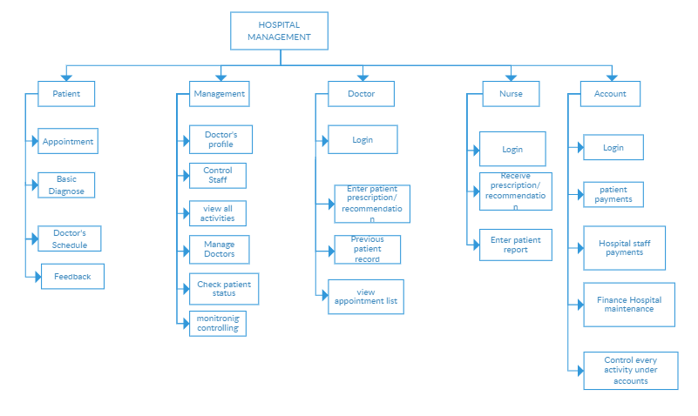

Slide 28
RISK MANAGEMENT:
Risk management is the process of identifying, assessing and controlling threats to an organization's capital and earnings. These threats, or risks, could stem from a wide variety of sources, including financial uncertainty, legal liabilities, strategic management errors, accidents and natural disasters.

Slide 29
RISK MANAGEMENT INCLUDES THE FOLLOWING TASKS:
Identify risks and their triggers.
Classify and prioritize all risks.
Craft a plan that links each risk to a mitigation.
Monitor for risk triggers during the project.
Implement the mitigating action if any risk materializes.
Communicate risk status throughout project.

Slide 30
RISK IDENTIFICATION:
Structured Brainstorming with team and stakeholders
Checklist is a list of actions/points to be considered [Information can be used from the similar previous projects]
Risk can be identified from
a) Assumption – Constraint analysis.
b) Swot Analysis (Strength/Weakness/Opportunity/Threat).

Slide 31
FIVE TYPES OF RISKS:
SCHEDULE RISK
BUDGET RISK
OPERATIONAL RISK
TECHNICAL RISK
PROGRAMMATIC RISK

Slide 32
MANAGING RISK:
1. Planning for Risks
2. Risk Identification
3. Risk Analysis
4. Responding to Risks
5. Monitoring Risks

Slide 33
ONLINE DOCTOR cONSULTANCY(week-6)
RA1911027010104( K.SNEHAL KUMAR(leader))
RA1911027010108(A.UDAY KIRAN REDDY)
RA1911027010109(N.VEERA VENKATA GANESH)

Slide 34
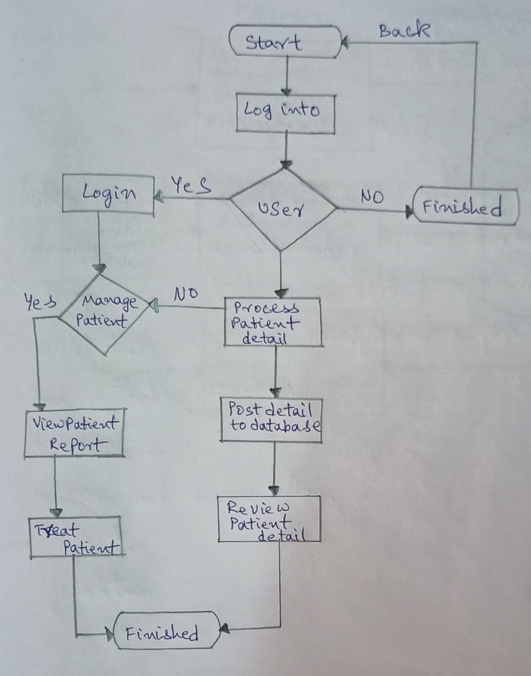
LOGICAL MODEL

Slide 35
SYSTEM ARCHITECTURE:
This gives a high level view of the new system with the main components of the system and the service they provide and how they communicate. The system is implemented using a three-tier architecture that comprises our interface, process management and DBMS as illustrated below.

Slide 36
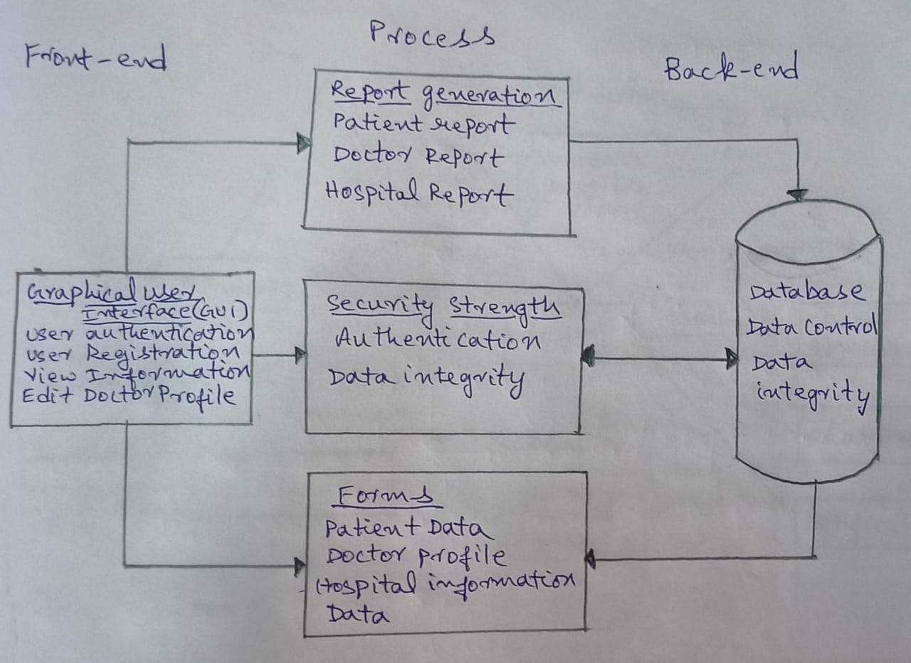

Slide 37
Use Case Diagram :
The use case diagram is a graphic depiction of the interaction among the elements of doctor appointment system . It represents the methodology used in system analysis to identify Clarify and organise system requirements of doctor appoinment system . The main actors of doctor appointment system in this use case diagram are : super admin , system user, doctor, patient , who perform the different types of use cases such as manage doctors , manage appointment , manage booking , manage fees ,manage shedule , manage clinic , manage user and full doctor appointment system operations. Major elements of the UML use case diagram of doctor appointment system .

Slide 38
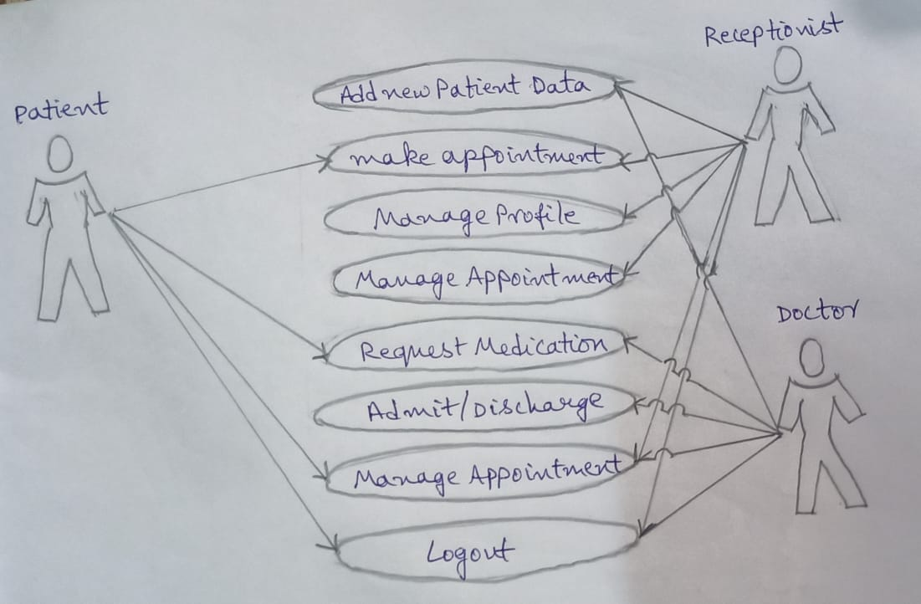
Use case diagram for Patient Appointment and Scheduling System

Slide 39
ER Diagram :
The ER diagram represents the model of doctor appointment system entity the entity relationship diagram of doctor appointment system shows all visual instruments of database tables and relationship between appointment ,fees , doctors , clinic etc .. data and to define the relation between structure data group of doctor appointment systrm functionality the main entity of the doctor appointment system are doctors , appointment , booking , fees , schedule , and clinics.

Slide 40
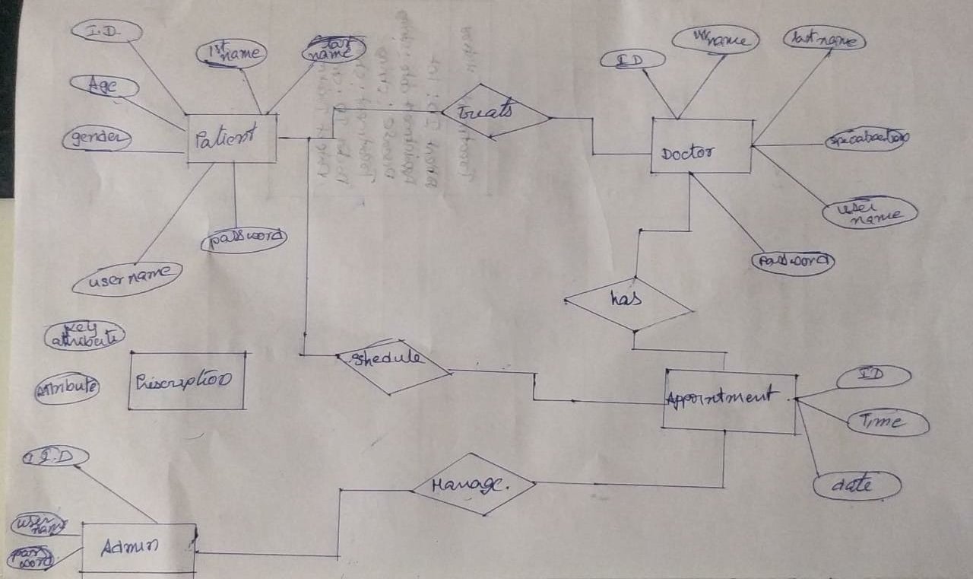

Slide 41
DFD Diagram :
A data-flow diagram is a way of representing a flow of data through a process or a system (usually an information system). The DFD also provides information about the outputs and inputs of each entity and the process itself. A data-flow diagram has no control flow, there are no decision rules and no loops. Specific operations based on the data can be represented by a Flow chart.
For each data flow, at least one of the endpoints (source and / or destination) must exist in a process. The refined representation of a process can be done in another data-flow diagram, which subdivides this process into sub-processes.

Slide 42
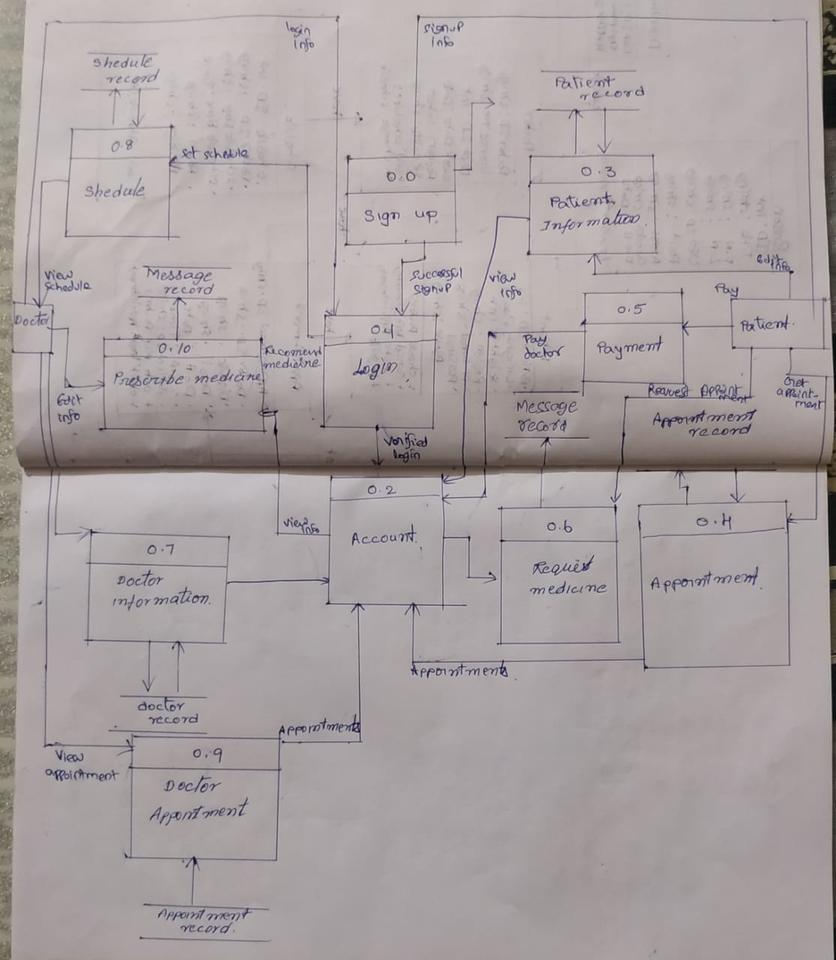

Slide 43
Class Diagram :
Classes of Clinic Apointment System Class Diagram
Clinic Class : Manage all the operations of Clinic
Patient Class : Manage all the operations of Patient
Doctors Class : Manage all the operations of Doctors
Booking Class : Manage all the operations of Booking
Appointments Class : Manage all the operations of Appointments
Doctors Schedule Class : Manage all the operations of Doctors Schedule

Slide 44
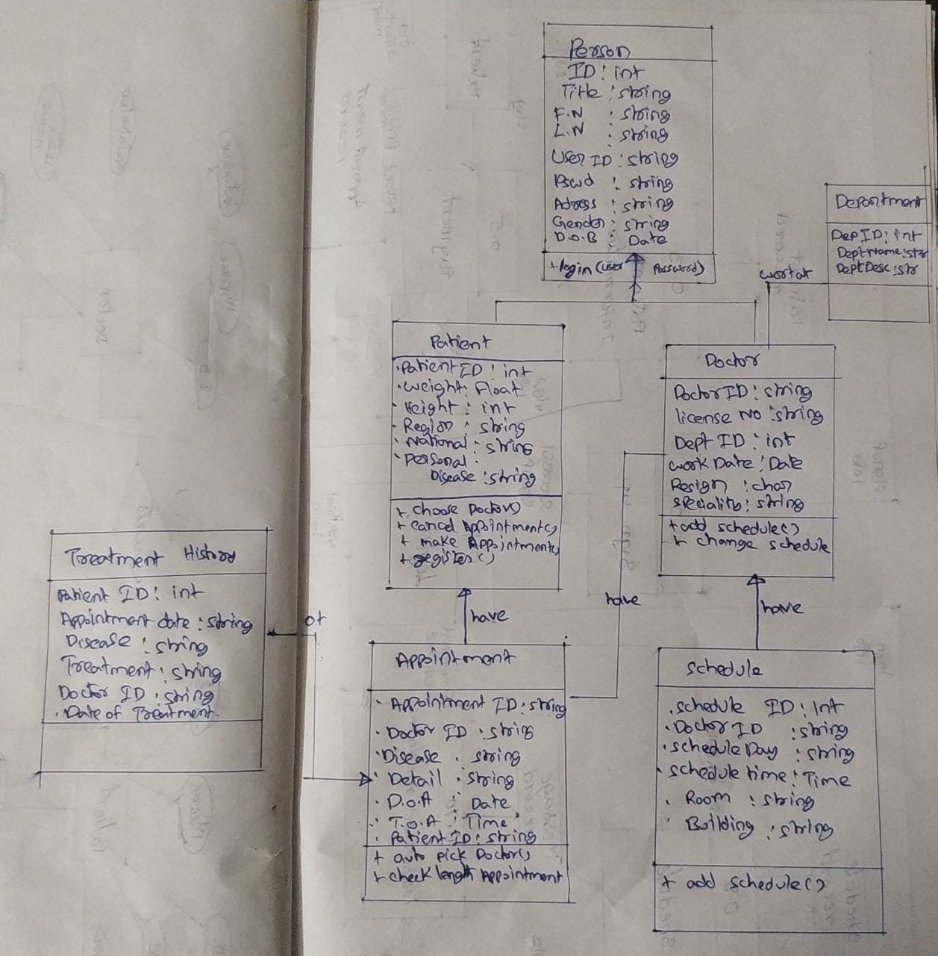

Slide 45
Sequence Diagram:
This is the UML sequence diagram of doctor appointment system which shows the interaction between the objects of appointment schedule Fees,Test,Doctors.The instance of class object involved in this UML sequence diagram of doctor appointment system .

Slide 46
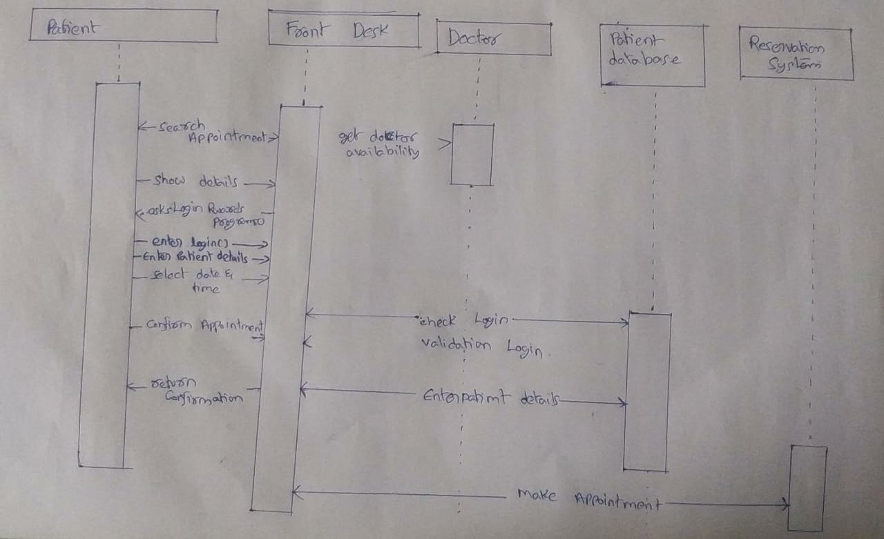

Slide 47
ONLINE DOCTOR cONSULTANCY (week-7)
RA1911027010104( K.SNEHAL KUMAR(leader))
RA1911027010108(A.UDAY KIRAN REDDY)
RA1911027010109(N.VEERA VENKATA GANESH)

Slide 48
State Diagram :
A state diagram is used to represent the condition of the system or part of the system at finite instances of time. It’s a behavioral diagram and it represents the behavior using finite state transitions. State diagrams are also referred to as State machines and State-chart Diagrams. These terms are often used interchangeably. So simply, a state diagram is used to model the dynamic behavior of a class in response to time and changing external stimuli. We can say that each and every class has a state but we don’t model every class using State diagrams. We prefer to model the states with three or more states.

Slide 49
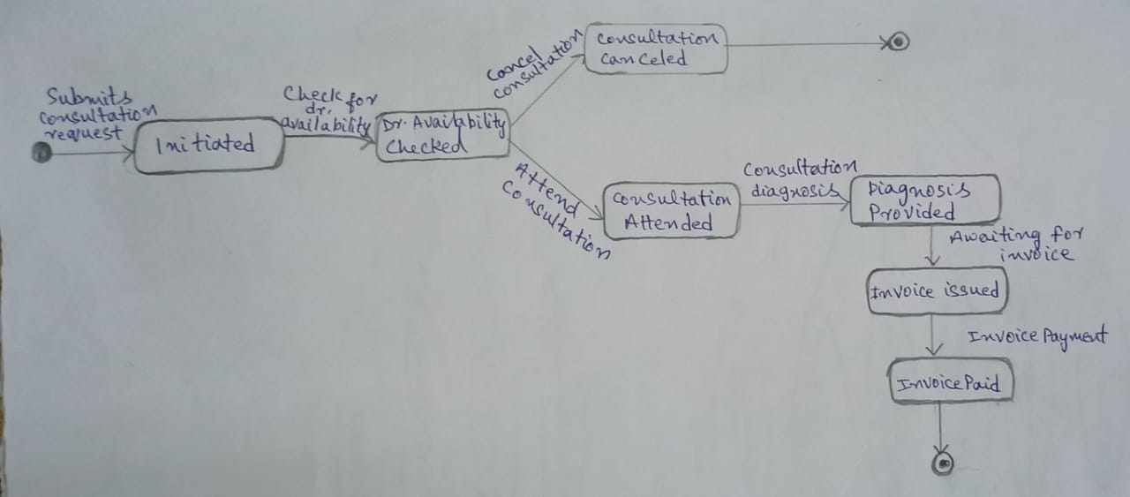

Slide 50
Collaboration Diagram :
The collaboration diagram is used to show the relationship between the objects in a system. Instead of showing the flow of messages, it depicts the architecture of the object residing in the system as it is based on object-oriented programming. An object consists of several features.

Slide 51
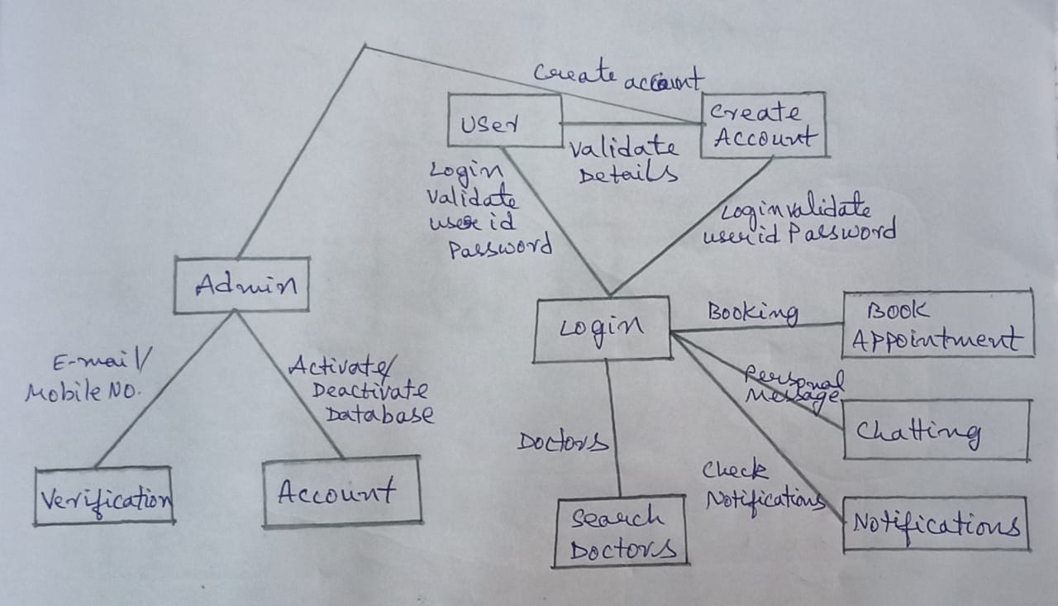

Slide 52
Deployment Diagram :
A Deployment diagram shows the configuration of run-time processing nodes and the components that live on them. Deployment diagrams address the static deployment view of architecture. They are related to component diagrams in that a node typically encloses one or more components.

Slide 53
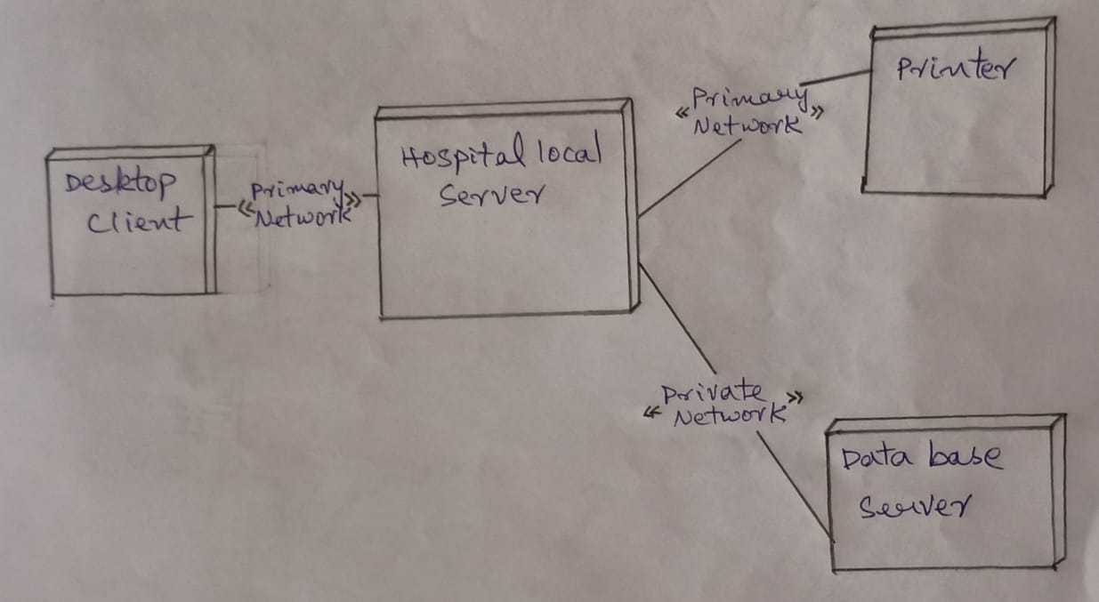

Slide 54
Modue description and implementation
ONLINE DOCTOR CONSULTANCY (week-8)
SNEHAL 104
UDAY 108
GANESH 109

Slide 55
CODE OF MODULE 1 HOME PAGE
<!DOCTYPE html>
<html>
<head>
<style >
html
{
background: url('p.jpg') no-repeat center fixed;
background-size: cover;
}
</style>
<title> ONLINE DOCTOR CONSULTANCY </title>
</head>
<body style="color: white">
<div style="color: white;">
<h1 style="padding:10px">ONLINE DOCTOR CONSULTANCY</h1>

Slide 56
<hr>
</div>
<div style="text-align: left;border: 5px solid white;border-radius: 40px;color:white;width:25%;height:50%;margin: auto;">
<p>Welcome to the most trusted webpage for ONLINE DOCTOR CONSULTANCY</p>
<p>Please Register if you are using our website for the first time.</p>
<a href="registar.html" style="text-align: center;" ><h3 style="color:black;background-color: white;border:5px;width:30%;">REGISTER</h3></a>
<p>Already Existing User</p>
<a href="login.html" style="text-align: center;" ><h3 style="color:black;border:5px;width:20%;background-color:white;text-align: center;">LOGIN</h3></a>
</div>
</body>
</html>

Slide 57
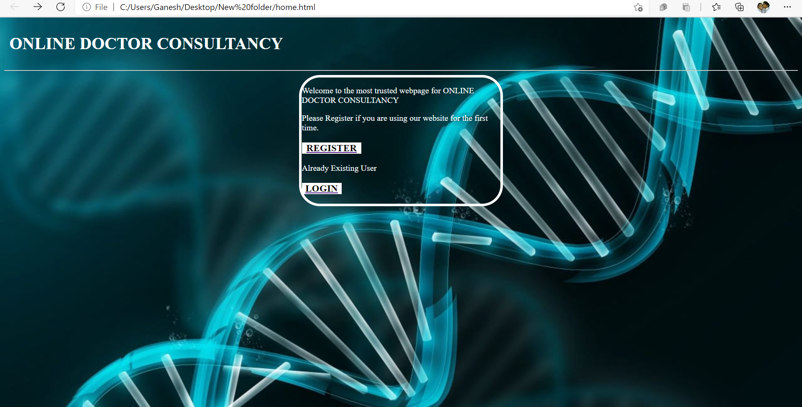

Slide 58
CODE OF MODULE 1 REGISTER PAGE
<!DOCTYPE html>
<html>
<head>
<style >
html {
background: url('pi.jpg') no-repeat center fixed;
background-size: cover;
}
</style>>
<title>ONLINE DOCTOR CONSULTANCY</title>
</head>
<body style="color: gray">
<h1 style="color: white">ONLINE DOCTOR CONSULTANCY</h1>
<hr>
<div style="color:white">
<div style="text-align: center;border: 5px solid white;border-radius: 5px;color:white;width: 25%;margin: auto;" >
<h3 style="padding: 2px">SIGN IN</h3>
<hr>
<p>

Slide 59
NAME: <input type="text" name="NAME">
</p>
<p>DATE OF BIRTH: <input type="date" name="date"></p>
<p>GENDER: <input type="radio" name="GENDER">MALE <input type="radio" name="GENDER">FEMALE</p>
<p>PHONE NUMBER: <input type="tel" name=""></p>
<p>EMAIL:<input type="email" name=""></p>
<p>PASSWORD:<input type="password" name=""></p>
<h3>MEDICAL INFORMATION</h3>
<p>HEIGHT:<input type="text" name=""></p>
<p>WEIGHT:<input type="text" name=""></p>
<p><a href="login.html" style="text-align: center;style=border: 5px;background-color:white;color:black;padding:5px;"name="">Submit</a></p>
<p><a href="home.html" style="text-align: center;style=border: 5px;background-color:white;color:black;padding:5px;"name="">Back</a></p>
</div>
</div>
</body>
</html>

Slide 60
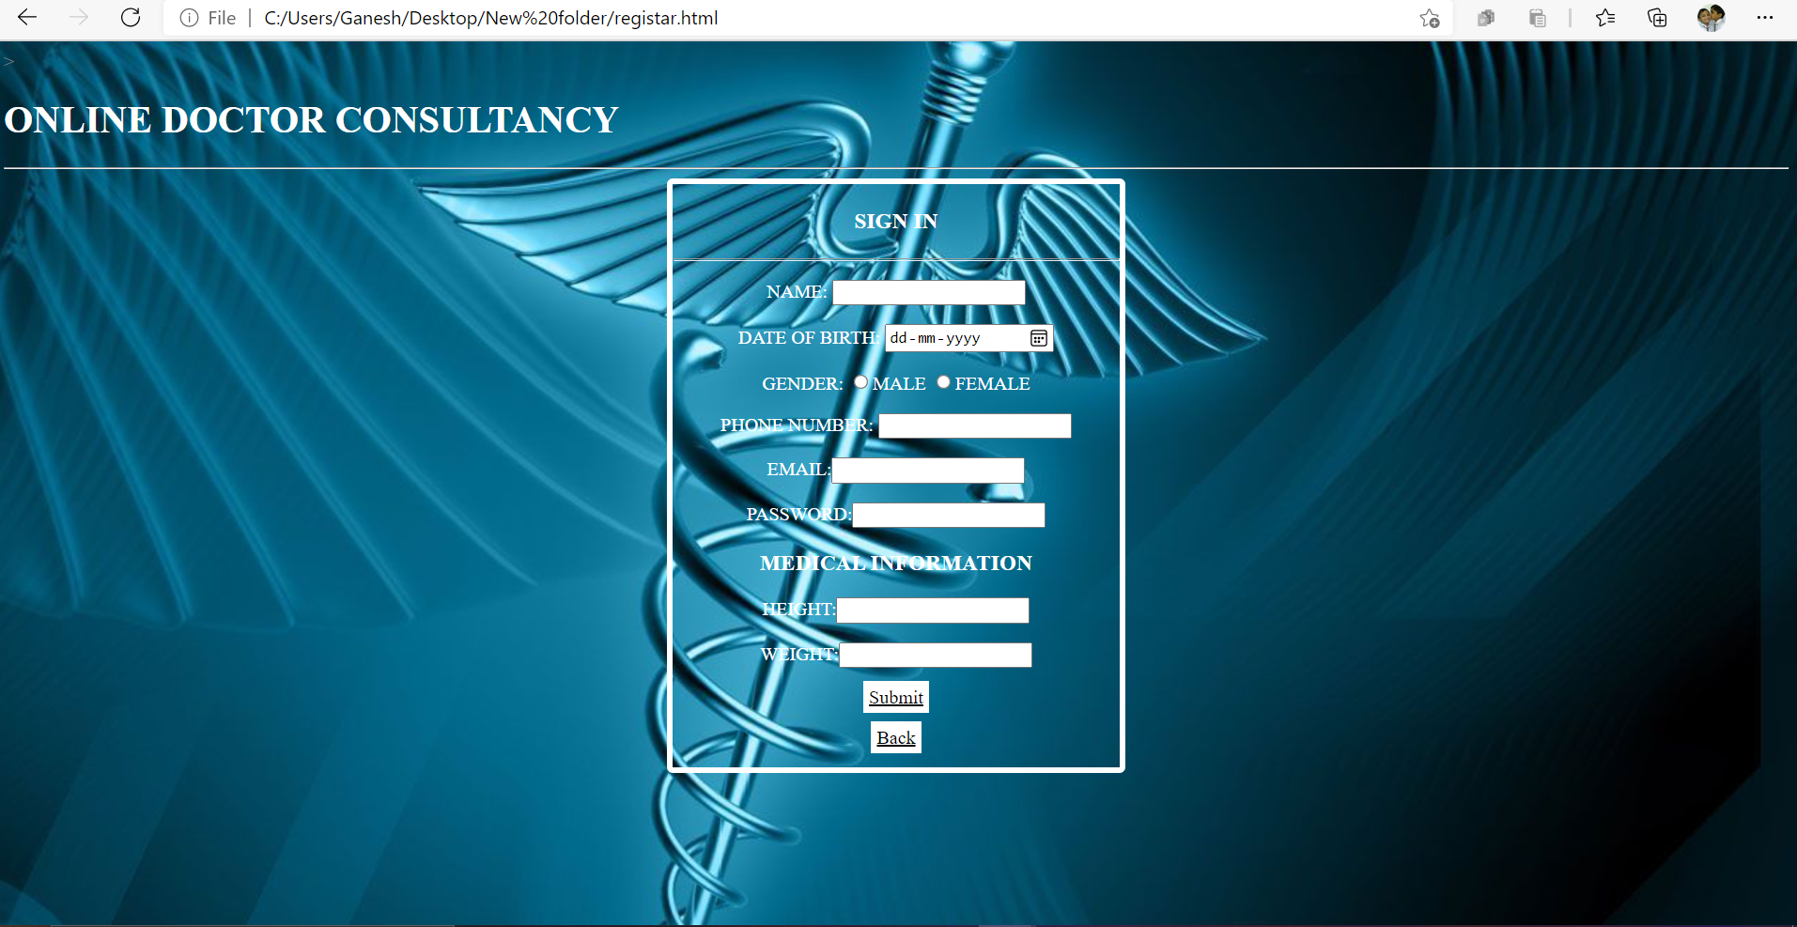

Slide 61
CODE OF MODULE 1 LOGIN PAGE
<!DOCTYPE html>
<html>
<head>
<style >
html {
background: url('pictu.jpg') no-repeat center fixed;
background-size: cover;
}
</style>>
<title>ONLINE DOCTOR CONSULTANCY </title>
<link rel="stylesheet" href="style.css">
<script src="script.js"></script>
</head>
<div class="header">
<h1 style="color: white">ONLINE DOCTOR CONSULTANCY</h1>
</div>

Slide 62
<div style="text-align: center;border: 5px solid white;border-radius: 20px;color:gray;width:40%;height:15%;color: white" class="container">
<h1>LOGIN </h1>
<hr>
<p>ENTER YOUR EMAIL</p>
<input type="text" id="id1" name="mailid" placeholder="Enter Email id">
<br>
<br>
<p>PASSWORD</p>
<input type="password" id="id2" name="pwd" placeholder="Enter password">
<br>
<br>
<button onclick="func()">Check</button>
<br>
<br>
<br>
<a style="color:white" href="levels.html" id="ref"></a>
<br>
<br>
</div>
</body>
</html>

Slide 63
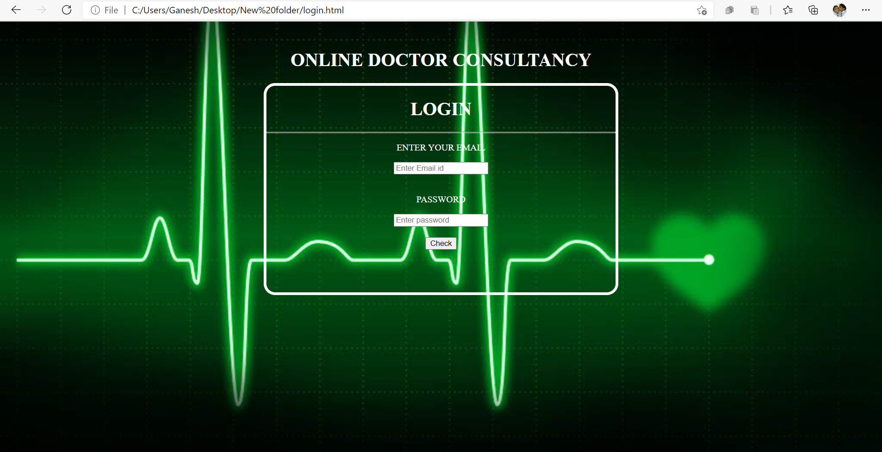

Slide 64
Modue description and implementation
ONLINE DOCTOR CONSULTANCY (WEEK-9)
SNEHAL 104
UDAY 108
GANESH 109

Slide 65
CODE OF MODULE 2 levels
<!DOCTYPE html>
<!DOCTYPE html>
<html>
<head>
<style>
html {
background: url('pic.jpg') no-repeat center fixed;
background-size: cover;
}
body {
margin: 0;
}
ul {
list-style-type: none;
margin: 0;
padding: 0;
width: 25%;
position: fixed;
height: 100%;
overflow: auto;
}

Slide 66
li a {
display: block;
color: #000;
padding: 8px 16px;
text-decoration: none;
}
li a.active {
background-color:gray;
opacity: 0.5;
color: white;
}
li a:hover:not(.active) {
background-color: gray;
opacity: 0.5;
color: white;
}
</style>
</head>
<body >

Slide 67
<h1 style="color: white;text-align: center;">ONLINE DOCTOR CONSULTANCY</h1>
<ul>
<li><a class="active" href="levels.html" style="color: white;" >Diabetic Level</a></li>
<li><a href="analysis.html"style="color: white;" >Problem of the Patient</a></li>
<li><a href="call.html"style="color: white;" >Call Doctor</a></li>
<li><a href="feedback.html"style="color: white;" >Feedback</a></li>
</ul>
<div style="text-align: left;margin-left:25%;padding:1px 16px;height:100%;width:80%">
<br>
<div style="text-align: center;border: 5px solid white;border-radius: 20px;color:gray;width:40%;height:15%;color: white">
<p><h3>Please enter your Level</h3></p>
<input id="numb" type="text">
<button type="button" onclick="myFunction()">Submit</button>
<p id="demo"></p>

Slide 68
<script>
function myFunction() {
var x, text;
x = document.getElementById("numb").value;
if (isNaN(x) || x < 1)
{
text = "Input not valid";
}
else if(x>1||x<100)
{
text = "Input OK";
}
else if(x>100||x<150)
{
text="";
}
else if(x>150||x<250)
{
text="";
}
else if(x>250||x<350)

Slide 69
{
text="";
}
else
{
text="";
}
document.getElementById("demo").innerHTML = text;
}
</script>
</div>
</div>
</body>
</html>

Slide 70
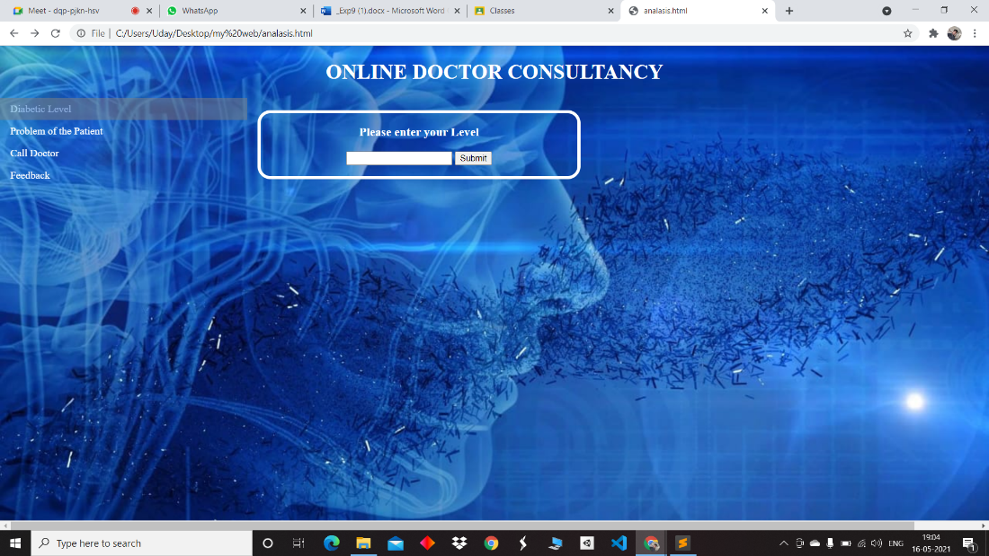

Slide 71
CODE OF MODULE 2 analysis
<!DOCTYPE html>
<!DOCTYPE html>
<html>
<head>
<style>
html {
background: url('picx.jpg') no-repeat center fixed;
background-size: cover;
}
body {
margin: 0;
}
ul {
list-style-type: none;
margin: 0;
padding: 0;
width: 25%;

Slide 72
position: fixed;
height: 100%;
overflow: auto;
}
li a {
display: block;
color: #000;
padding: 8px 16px;
text-decoration: none;
}
li a.active {
background-color:gray;
opacity: 0.5;
color: white;
}

Slide 73
li a:hover:not(.active) {
background-color: gray;
opacity: 0.5;
color: white;
}
</style>
</head>
<body onload='document.form1.text1.focus()'>
<h1 style="color: white;text-align: center;">ONLINE DOCTOR CONSULTANCY</h1>
<ul>
<li><a class="levels.html" href="levels.html" style="color: white;" >Diabetic Level</a></li>
<li><a href="active"style="color: white;" >Problem of the Patient</a></li>
<li><a href="call.html"style="color: white;" >Call Doctor</a></li>
<li><a href="feedback.html"style="color: white;" >Feedback</a></li>
</ul>

Slide 74
<div style="text-align: left;margin-left:25%;padding:1px 16px;height:100%;width:80%">
<div class="mail" style="text-align: center;border: 5px solid white;border-radius: 20px;color:gray;width:40%;height:15%;color: white">
<p><h2>Post your Problem</h2></p>
<form name="form1" action="#">
<ul>
<br>
<li><input type='text' name='text1'/></li>
<br>
<li><input type="submit" name="submit" value="Submit" onclick="alphanumeric(document.form1.text1)" /></li>
<li>&nbsp;</li>
</ul>
</form>
</div>
<script>
function alphanumeric(inputtxt)
{
var letters = /^[0-9a-zA-Z]+$/;
if(inputtxt.value.match(letters))

Slide 75
{
alert('Problems has been noted:Any more write below');
document.form1.text1.focus();
return true;
}
else
{
alert('Please input alphanumeric characters only');
return false;
}
}
</script>
</div>
</div>
</body>
</html>

Slide 76
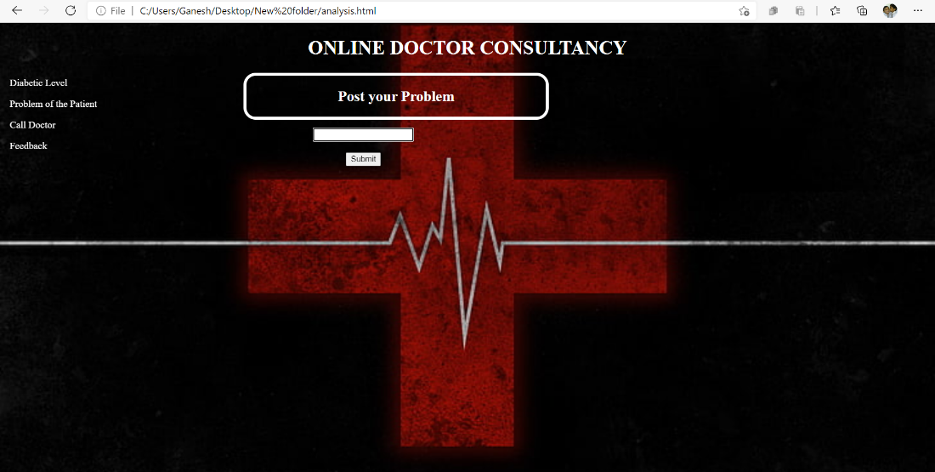

Slide 77
CODE OF MODULE 2 call
<!DOCTYPE html>
<!DOCTYPE html>
<html>
<head>
<style>
html {
background: url('pix.jpg') no-repeat center fixed;
background-size: cover;
}
body {
margin: 0;
}
ul {

Slide 78
list-style-type: none;
margin: 0;
padding: 0;
width: 25%;
position: fixed;
height: 100%;
overflow: auto;
}
li a {
display: block;
color: #000;
padding: 8px 16px;
text-decoration: none;
}

Slide 79
li a.active {
background-color:gray;
opacity: 0.5;
color: white;
}
li a:hover:not(.active) {
background-color: gray;
opacity: 0.5;
color: white;
}
</style>
</head>
<body>
<h1 style="color: white;text-align: center;">ONLINE DOCTOR CONSULTANCY</h1>
<ul>

Slide 80
<li><a href="levels.html" style="color: white;" >Diabetic Level</a></li>
<li><a href="analysis.html"style="color: white;" >Problem of the Patient</a></li>
<li><a class="active" href="call.html"style="color: white;" >Call Doctor</a></li>
<li><a href="feedback.html"style="color: white;" >Feedback</a></li>
</ul>
<div style="margin-left:25%;padding:1px 16px;height:1000px;">
<br>
<div style="text-align: center;border: 5px solid white;border-radius: 20px;color:gray;width:40%;height:15%;color: white">
<h3>Please stay online till our Doctor arrives</h3>
<a class= "active" href="https://meet.google.com/eet-mouk-zkf" target="blank" style="background-color: white;color :black ;border:5px;border-radius: 10px;padding:10px;text-align: center;margin:auto;">Call</a>
</div>
</div>
</body>
</html>

Slide 81
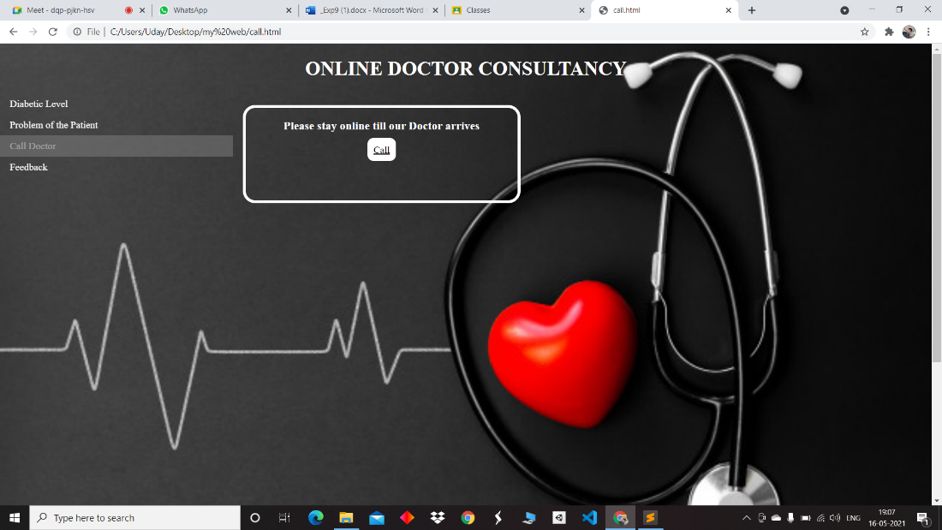

Slide 82
Modue description and implementation
ONLINE DOCTOR CONSULTANCY (WEEK-10)
SNEHAL 104
UDAY 108
GANESH 109

Slide 83
CODE OF MODULE 3 Feedback form
<!DOCTYPE html>
<html>
<head>
<meta name="viewport" content="width=device-width, initial-scale=1">
<style>
* {
background: url('p.jpg') no-repeat center fixed;
background-size: cover;
box-sizing: border-box;
}
input[type=text], select, textarea {
width: 100%;
padding: 12px;
border: 1px solid rgb(70, 68, 68);
border-radius: 4px;
color: white;
resize: vertical;
}

Slide 84
input[type=email], select, textarea {
width: 100%;
padding: 12px;
border: 1px solid rgb(70, 68, 68);
border-radius: 4px;
resize: vertical;
color:white;
}
label {
padding: 12px 12px 12px 0;
display: inline-block;
}
input[type=submit] {
background-color: rgb(37, 116, 161);
color: white;
padding: 12px 20px;
border: none;
border-radius: 4px;
cursor: pointer;
float: right;
}

Slide 85
input[type=submit]:hover {
background-color: white;
}
.container {
border-radius: 5px;
background-color: #f2f2f2;
padding: 20px;
}
.col-25 {
float: left;
width: 25%;
margin-top: 6px;
}
.col-75 {
float: left;
width: 75%;
margin-top: 6px;
color:black;
}
ext

Slide 86
.row:after {
content: "";
display: table;
clear: both;
}
/* Responsive layout - when the screen is less than 600px wide, make the two columns stack on top of each other insteadof next to each other */
</style>
</head>
<body style="color: white">
<h2>FEED BACK FORM</h2>
<div class="container">
<form>
<div class="row">
<div class="col-25">
<label for="fname">First Name</label>
</div>
<div class="col-75">
<input type="text" id="fname" name="firstname" placeholder="Your name..">
</div>
</div>
<div class="row">
<div class="col-25">
<label for="lname">Last Name</label>
</div>
<div class="col-75">

Slide 87
<div class="col-25">
<label for="country">Country</label>
</div>
<div style="background color:black"class="col-75">
<select id="country" name="country">
<option value="none">Select Country</option>
<option value="australia">Australia</option>
<option value="canada">Canada</option>
<option value="usa">USA</option>
<option value="russia">Russia</option>
<option value="japan">Japan</option>
<option value="india">India</option>
<option value="china">China</option>
</select>
</div>
</div>
<div class="row">
<div class="col-25">
<label for="feed_back">Feed Back</label>
</div>
<div class="col-75">
<textarea id="subject" name="subject" placeholder="Write something.." style="height:200px"></textarea>

Slide 88
</div>
</div>
<div class="row">
<p><a href="submit.html" style="float:right;border: 5px;background-color:white;color:white;padding:5px;"name=""><h3>submit</h3></a></p>
</div>
</form>
</div>
</body>
</html>

Slide 89
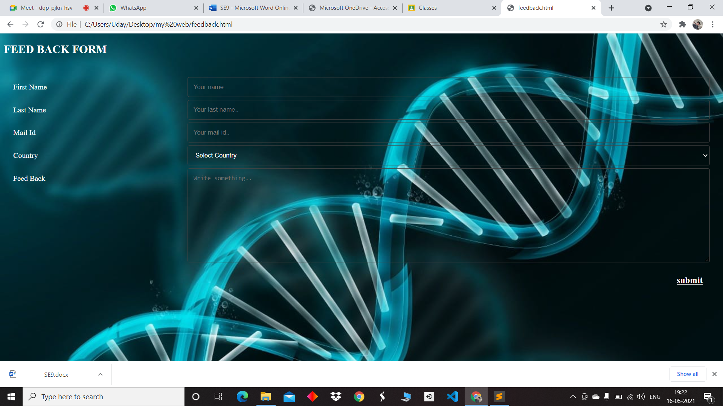

Slide 90
CODE OF MODULE 3 SUBMIT PAGE
<!DOCTYPE html>
<html>
<head>
<style>
html {
background: url('pk.jpg') no-repeat center fixed;
background-size: cover;
}
body {
margin: 0;
}
ul {
list-style-type: none;
margin: 0;
padding: 0;
width: 25%;
position: fixed;
height: 100%;
overflow: auto;
}

Slide 91
li a {
display: block;
color: #000;
padding: 8px 16px;
text-decoration: none;
}
li a.active {
background-color:gray;
opacity: 0.5;
color: white;
}
li a:hover:not(.active) {
background-color: gray;
opacity: 0.5;
color: white;
}
</style>
</head>
<body>
<h1 style="color: white;text-align: center;">ONLINE DOCTOR CONSULTANCY</h1>
<ul>

Slide 92
<li><a href="levels.html" style="color: white;" >Diabetic Level</a></li>
<li><a href="analysis.html"style="color: white;" >Problem of the Patient</a></li>
<li><a href="call.html"style="color: white;" >Call Doctor</a></li>
<li><a class="active"href="feedback.html"style="color: white;" >Feedback</a></li>
</ul>
<div style="margin-left:25%;padding:1px 16px;height:1000px;">
<br>
<div style="text-align: center;border: 5px solid white;border-radius:20px;color:gray;width:40%;height:15%;margin: auto;color: white">
<p>
YOUR FEEDBACK IS SUBMITTED!!
</p>
</div>
</div>
</body>
</html>

Slide 93
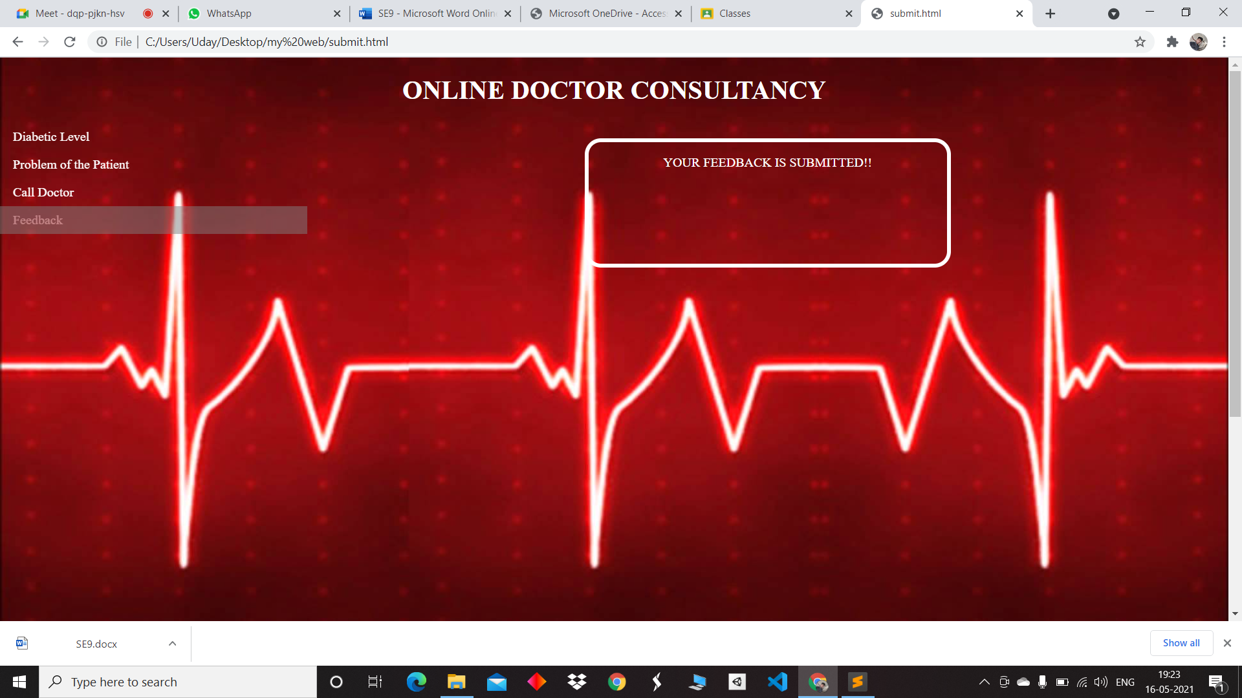

Slide 94
ONLINE DOCTOR CONSULTANCY (week-11)
RA1911027010104( K.SNEHAL KUMAR(LEADER))
RA1911027010108(A.UDAY KIRAN REDDY)
RA1911027010109(N.VEERA VENKATA GANESH)

Slide 95
Scope of Testing
Functional:
1] Dynamic web interface
2]System authorities.
3] Personal information.
4] Medical conditions
5]The system shall support multiple logs

Slide 96
Scope of Testing
Non-Functional:
1]Performance
2]Availability
3]Scalability
4]Confidentiality
5]Compliance
6]Usability
7]Reliability

Slide 97
Types of Testing , Methodology , Tools
Category | Methodology | Tools Required
Functional Requirements | Manual | By opening the website and checking all the functional requirements as mentioned above.
Non - Functional Requirements | Manual, Automation | By opening the website and checking all the non functional requirements as mentioned above.And test cases are successful.

Slide 98
Sample Test Cases for Online Doctor Consultancy:
Verify that the portal for new patient registration has all the mandatory fields required for registering a patient.
Verify that the system has an admin for doctors as well.
Verify that the doctor’s record can be deleted from the system.
Verify the levels and give the analysis.
Verify that you can post your problem to the doctor.
Verify that you can give your feedback.

Slide 99
Functional Test Case :
Adding Patients.
Information of the Patient.
Mandatory Patient Information.
Updating information of the Patient.

Slide 100
Non Functional Test Cases:
Patient Identification.
Login ID.
Modifications.
Response Time.
User-Interface.

Slide 101
ONLINE DOCTOR CONSULTANCY (week-12)
RA1911027010104( K.SNEHAL KUMAR(LEADER))
RA1911027010108(A.UDAY KIRAN REDDY)
RA1911027010109(N.VEERA VENKATA GANESH)

Slide 102
Defect Log
Requirement # | Defect ID # | Defect Description | Assignee | Status
M1R1 | ID 1 | Incorrect display on different resolution screens | SNEHAL | COMPLETED
M1R2 | ID 2 | An application consumes too much of the device’s resources | GANESH | WORKING
M1R3 | ID 3 | The application isn’t launched in the first 5-10 sec | UDAY | WORKING

Slide 103
Test Report
Category | Progress Against Plan | Status
Functional Testing | Green | Completed
Non-Functional Testing | Amber | In-Progress
Functional | Test Case Coverage (%) | Status
Module ID-1 | 100% | Completed
Module ID-2 | 70% | In-Progress
Module ID-3 | 80% | In-Progress

Slide 104
THANK YOU
A SWEET ENDING FOR A HEALTHY BEGINNING OF LIFE ! ! ! !

